Slide 1



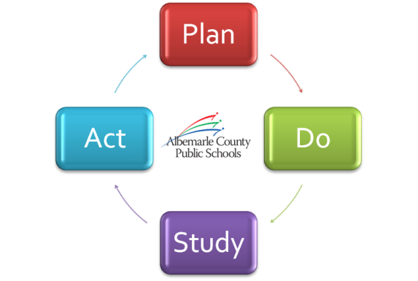


A Look at Our Strategic Performance
2013-14 EOY Progress Summary
June 12, 2014

Slide 2
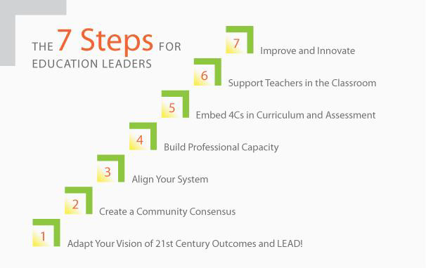
Strategic Planning Toward 21st Century Learning
Notes:
Steps 1 & 2: Community Conversation / Strategic Plan Comprehensive Review during the spring of last year. We asked questions to build consensus.
Question 1: What will the world be like twenty or so years from now, when the children who visit
your institution are out in the world?
Question 2: What skills will these children need to be successful in this world you have imagined
twenty years from now?
Question 3: (Think about your own life and those times when you have had a ‘peak’ learning
experience.) What were the conditions that made your high-performance learning experiences so
powerful?
Question 4: What would learning be like if it were designed around the answers to the first three
questions?
With those four questions, and interactions both face to face and through community and school surveys, we were able to build a consensus for our vision for 21st Century Learning and focus on one, student centered goal.
We continue to work on all fronts for three through 7, building alignment, for example by using the TPA and APA as our standards for recruiting and hiring as well as goal setting and appraisal.
Step 4: This summer’s professional development for all teachers around digital curriculum and the seven pathways is a major effort to build professional capacity.
Step 5: Embedding the Life-Long Learning Competencies in our curriculum has been an ongoing and successful project. Transitioning to performance assessments for targeted LLLC is a key step, as we move from valuing what we have to measure to measuring what we value: hire order thinking through engaging instruction and work.
Step 6: Providing teachers with the resources they need through digital integration, modernization of spaces, access to professional development, such as responsive classroom training.
Step 7: Every school, every department, makes a plan annually to improve and innovate toward a desired state where we unleash every student’s potential.

Slide 3
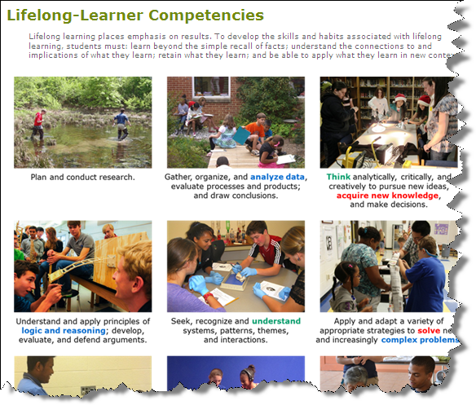
1 Goal
Lifelong Learning
*Student-Centered
*All Albemarle County Public Schools students will graduate having actively mastered the lifelong-learning skills they need to succeed as 21st century learners, workers, and citizens.

Slide 4
Objective 1
Effective Teaching Practices
Professional Development
Objective 2
LLLC Measures
Objective 3
Transition
Objective 4
Objective 5
School Community Health / Safety
Contemporary Learning Spaces
Performance-Based Assessments
World Language Program
Mentorship & Internship
Community Support
Optimize Fiscal Resources
High School of the Future
Engage Every Student
Balanced Assessments
Opportunity & Achievement
Partnerships
Optimize Resources

Slide 5
Process Expectations
June 2 Retreat – initial exposure to new reporting/rating format, feedback, discussion.
June 12 Business Session – updated report based on retreat feedback. Objectives 1,2,3 provided. Review rating scale and process.
June 26 Work Session – Final Report with all priorities updated. Board will provide individual evaluations via Google form ahead of time; will come to rating consensus at meeting and provide direction for Priorities and Strategies going forward.

Slide 6
Evaluating Priorities
Using the rubric to decide the level of impact a priority is having.
Discussing ways to fine tune the priority and strategies to improve the impact.
Assumptions
Impact
Transformation& Innovation
Inputs
Development & Planning
Activities
Application
Outputs
Integration
Your planned work
Your intended results
Logic Model Approach

Slide 7
5Transformation
Transformation / Innovation of the Priority across the Division. Strong evidence exists that the division has implemented the core of its vision, goal, and this priority. Evidence exists to show that the Division is experiencing a demonstrable change in paradigm and outcomes as a result of this priority.
4 Integration
Results show Integration of the Priority across the Division. Considerable evidence exists for attention to the priority both in terms of outputs for teaching and learning and for operations. Implementation of the division’s vision through purposeful, systemic implementation of this priority is well documented.
3 Application
Results show Application of the Priority across the Division. Considerable evidence of attention exists for this priority, particularly in the area of planning. There appears to be a foundation of broad implementation and execution through inputs that will impact outcomes for teaching, learning, and operations.
2 Development
1 Absence
Results show Development of the Priority across the Division. Adequate evidence of attention exists for this priority, particularly in the area of planning. There appears to be a foundation of variable implementation and execution through inputs that will impact outcomes.
Results show Absence of Development of this Priority across the Division. Evidence does not exist to indicate systemic attention to planning or execution for this priority across the Division that will impact outcomes for teaching, learning, and operations.
Evidence of Impact
Evidence of Output
Evidence of Input
Evidence of Input
No Evidence
Notes:
Evidence of Impact – student performance task/learning scores demonstrate excellence as an example.
Evidence of Output- progress shown towards achievement of the priority – performance learning/task data is being collected and scored
Evidence of Input affecting whole division – increase likelihood of achieving expected outputs –professional work and development related to performance task/learning applications has occurred with consistency across division as example
Evidence of Input – increase likelihood of achieving expected outputs affected some in the division – professional work and development related to performance task/learning applications has occurred with inconsistency across division.
No evidence

Slide 8
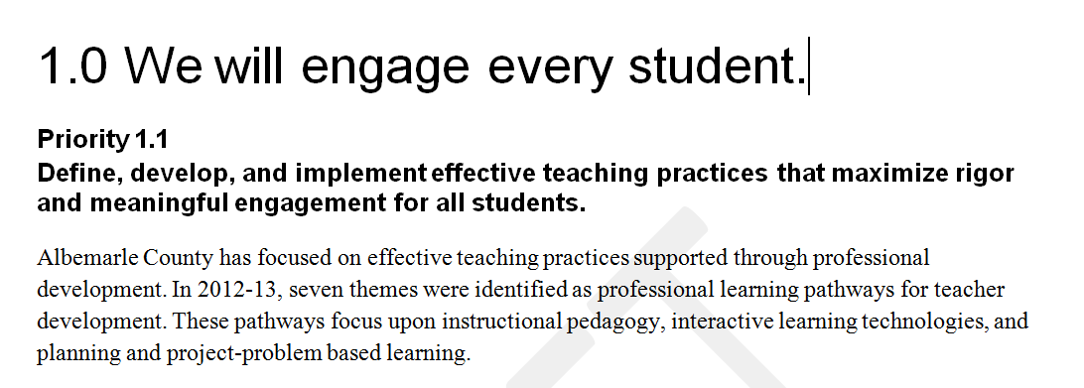
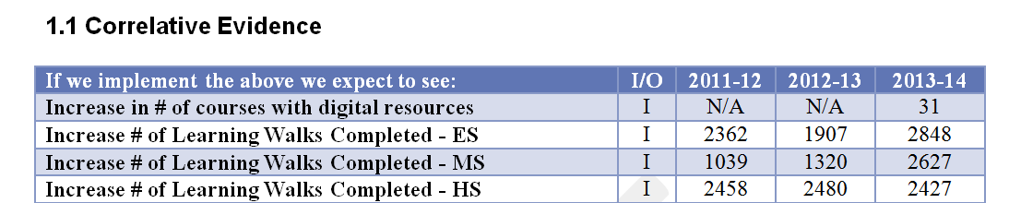
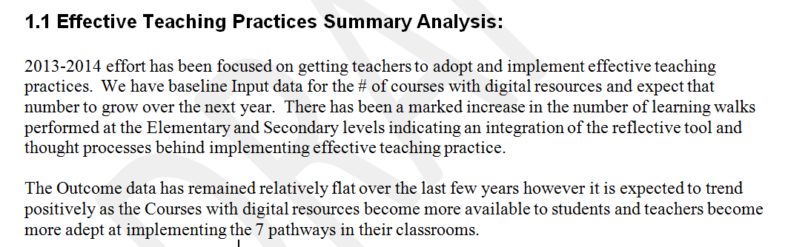
3-Part Report Format
Priority Summary of Division Strategies - what activities and actions have been taken.
“What have we done?”
Listing of Performance Indicators.
“If we do this Strategy we expect to see this Performance Indicator change.”
Analysis of Performance Indicator Trends, next steps, and future expectations.

Slide 9
Board Discussion Questions
Does the Priority Summary describe the assumed impact of the priority?
  Does it affirm the direction we are taking as a division?
  Are the actions described related to accomplishing the priority?
Does the Correlative Evidence support the desired impact of the priority and associated strategic objective? Is there other data available?
What Analysis would you make of the correlative evidence? What else would you expect?

Slide 10
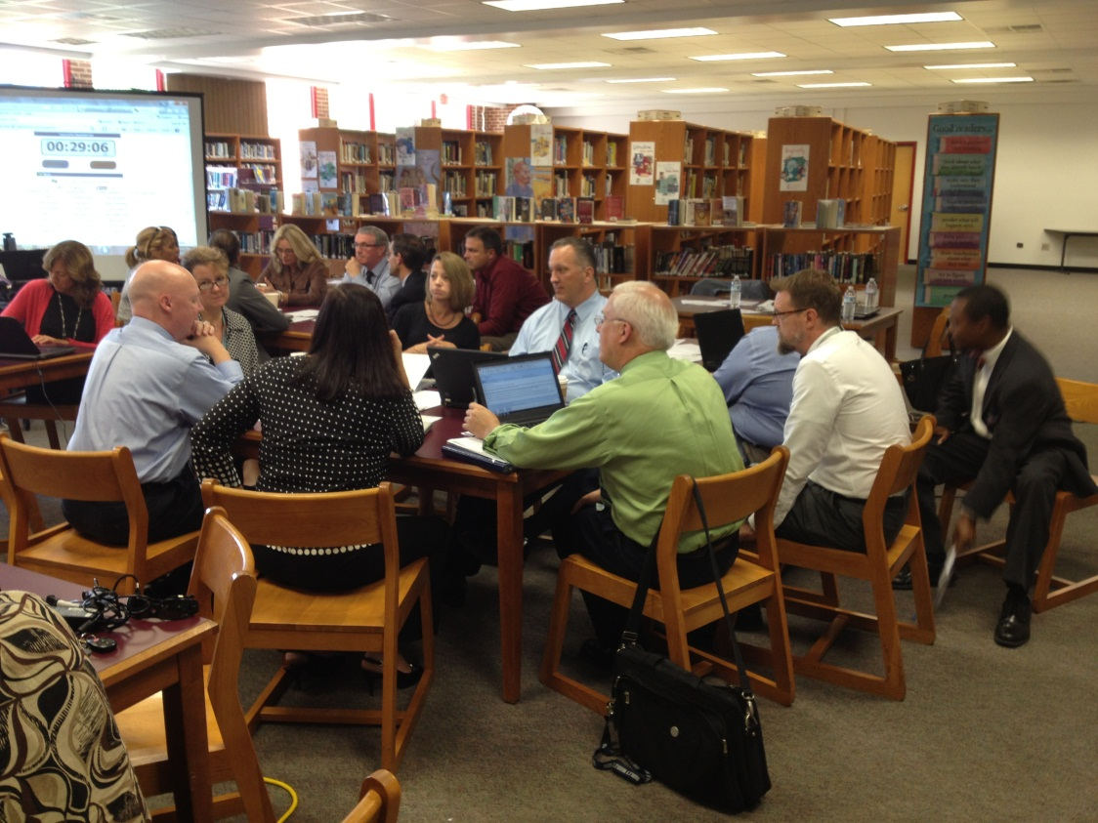
Discussion / Questions / Comments

